Slide 1
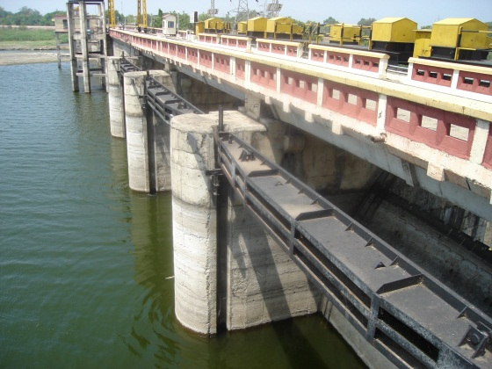
Hydrological Information System
Module – Integrated Reservoir Monitoring System

Slide 2
Examples that refer to products are intended for illustrative purposes only, and do not imply an endorsement or recommendation of any particular product

Slide 3
Integrated Reservoir Monitoring System
Components:
Inflow Monitoring
Main River
Tributaries
Rainfall on Reservoir Area
Outflow Monitoring
Flow through Spillway
Flow from Canals
Change in Storage
Change in Water Levels (through Elevation Area Volume Curves)
Evaporation loss (through Meteorological parameters)
Spillway
(Gate Level Sensors)
Canal Outlets
(Gate Level Sensors)
Change in Storage
(Water Level Sensors)
Reservoir
Evaporation Loss
(Automatic Weather Station)
Inflow
(Water Level Sensors)
Rainfall
(Automatic Rain Gauge)

Slide 4
Integrated Reservoir Monitoring System
Inflow
Water level recorder in upstream of reservoir preferably at the bridge
Storage
Water level:: Shaft encoder if stilling well exists or Radar/Ultrasonic in reservoir
Spillway Outflow
Water level in the downstream of spillway in the river.
Gated Spillway: Gate sensors to monitor opening and estimate discharge
Canal Outflow
Gated Spillway: Gate sensors to monitor opening and estimate discharge
Water level in the downstream of spillway in canal
Introduction

Slide 5
Options for Reservoirs
Need all components of reservoir water balance
Inflow + outflow + change in Storage = 0
If sensors are installed for 2 components, third can be estimated
However, if all three components are not measured, the losses of reservoir (evaporation and seepage) would be counted towards underestimated inflow or overestimated outflow
Inflow Sensors
On all tributaries contributing to inflow
Outflow Sensors
Gate Sensors On all Gates of Spill, Canals
or at location downstream in all canals and River outflow
Reservoir Water Level Sensor – On the Dam
Introduction

Slide 6
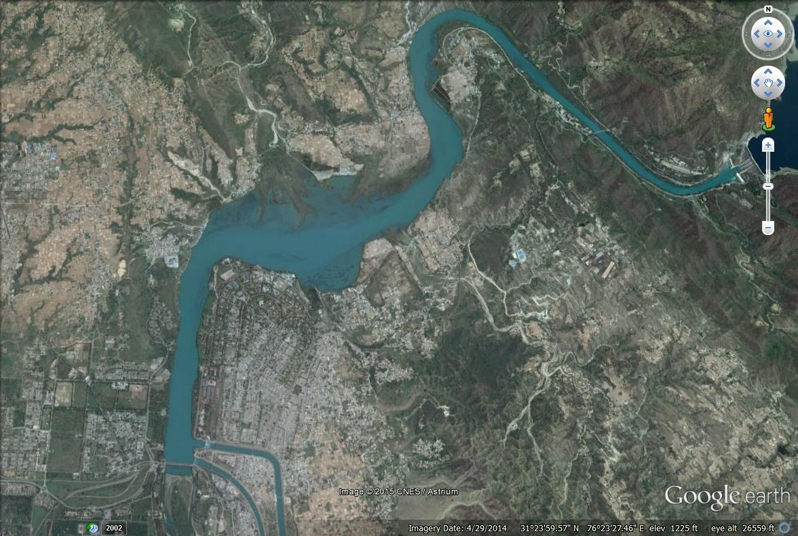
Reservoir Monitoring Example 1
Inflow Sensor on Bridge Upstream
Reservoir Water Level Sensor in Stilling Well
Canal 1 Water Level radar 100 m Away from Gates
Canal 2 Water Level shaft encoder in Stilling Well

Slide 7
Criteria for selection
Reservoir Water Level
First option is Shaft Encoder or Ultrasonic sensor if Gauge well available
Second option is Radar from top of Dam, down looking at suitable location upstream side
If none is available, Bubbler on upstream side of Dam
Reservoir Monitoring - 1

Slide 8
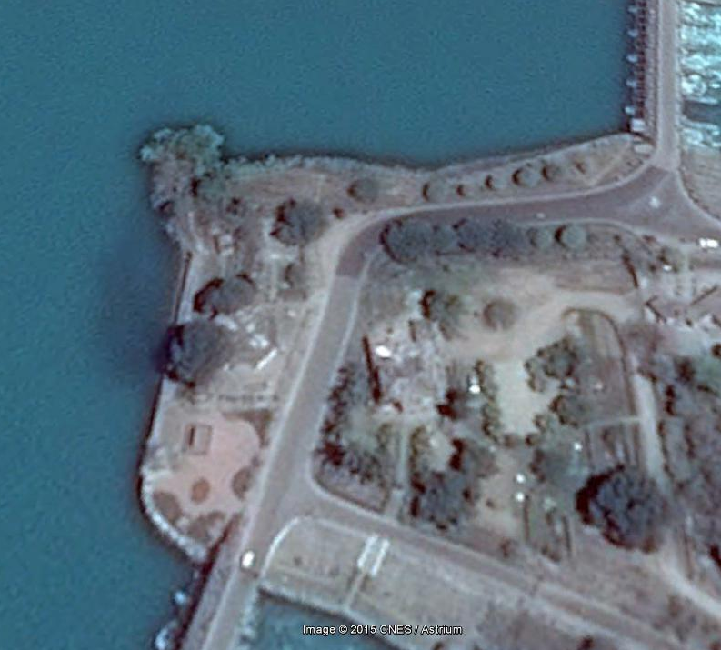
Reservoir Monitoring Example 1
Reservoir Water Level Sensor (Shaft Encoder) on stilling Well

Slide 9
Criteria for selection
Inflow
Inflow sensor on all Tributaries contributing to Reservoirs
A location upstream of reservoir, such that water level in river is always ABOVE Full reservoir level (otherwise the station will be submerged when reservoir is full)
Sometime the suitable location could be kilometers away, depending on size of reservoir
Reservoir Monitoring - 1

Slide 10
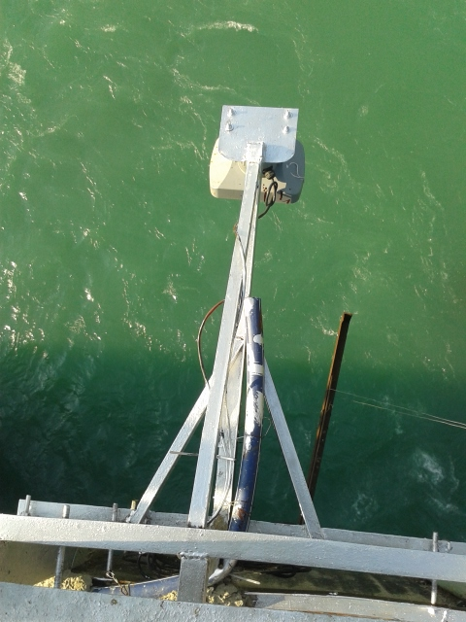
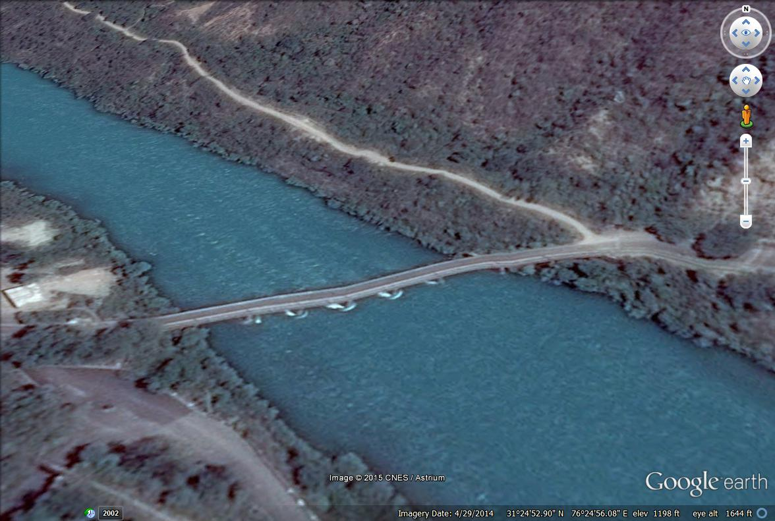
Reservoir Monitoring Example 1
Reservoir Inflow Radar on Bridge

Slide 11
Criteria for selection
Outflow
Option 1 – Gate sensors on all canals and river outlet
Needed on all gates
May be suitable option if Automation of Canal gates is needed in future
Expansive option if number of gates is high
Can share same telemetry infrastructure of Dam level sensor as distance is short
Can be calibrated for discharge measurements, no rating curve needed
Option 2 – Water level sensors on all canals and River outlet
Might need own telemetry system, as distance from Dam could be high
Would need rating curves for all water level locations
A combination of options, with Water level in canals and Gate sensors for spillway / river outlet
A compromise would be needed based on number of sensors needed and number of telemetry stations needed
If the hydropower is installed, it is possible to tap energy generation (for each turbine) from SCADA system and using rating curve of turbines, outflow may be estimated
Reservoir Monitoring - 1

Slide 12
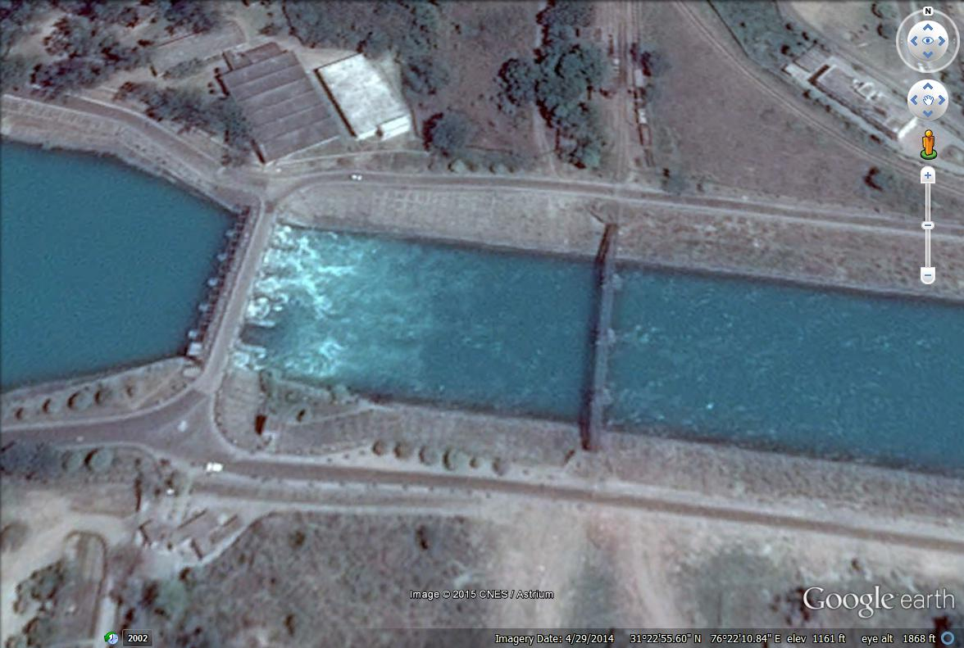
Reservoir Monitoring Example 1
Canal 1 Water Level radar 100 m away from Gates

Slide 13
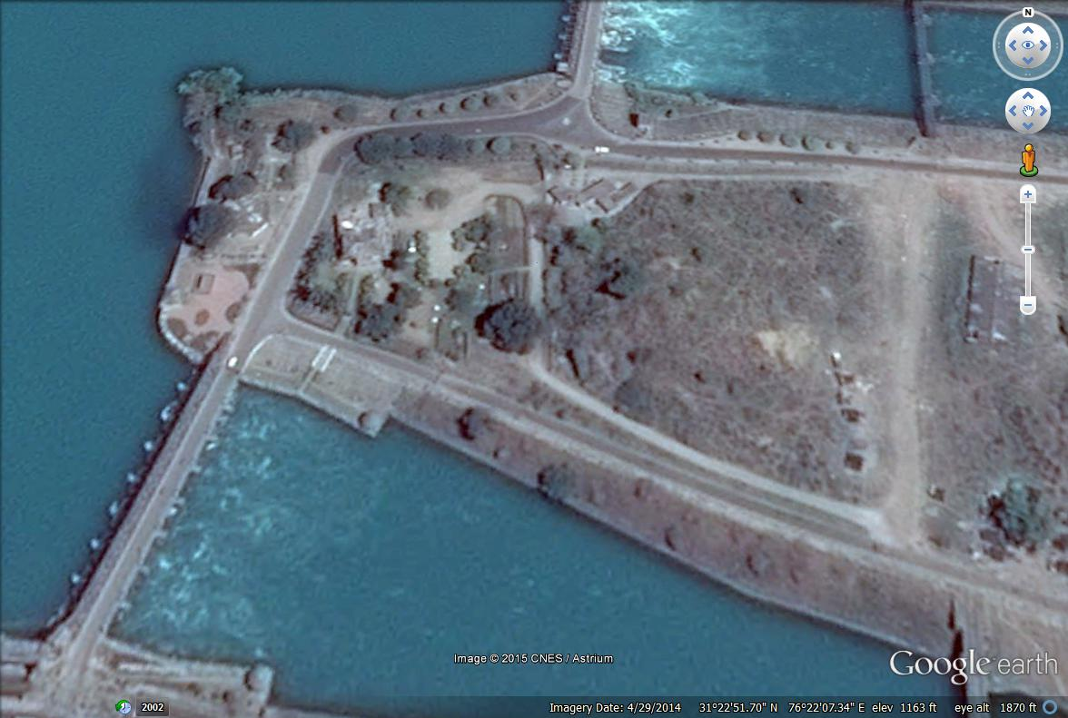
Reservoir Monitoring Example 1
Canal 2 Water Level Shaft Encoder on Stilling Well

Slide 14
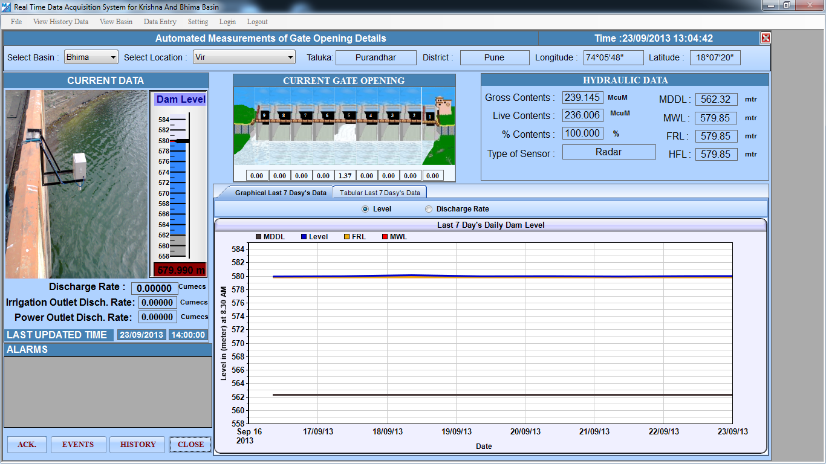
Reservoir Monitoring Example 2
Reservoir Monitoring - 2
Outflow Gate Sensors
Reservoir Water level Sensor

Slide 15
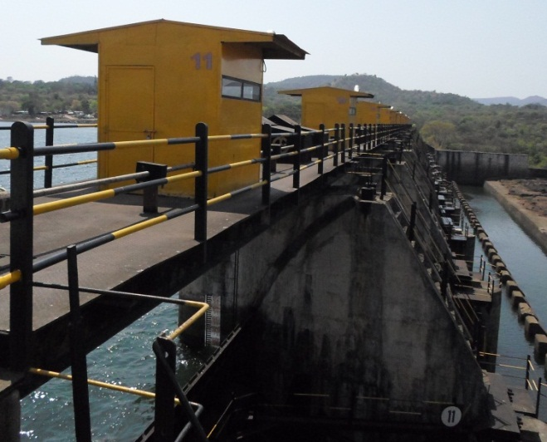
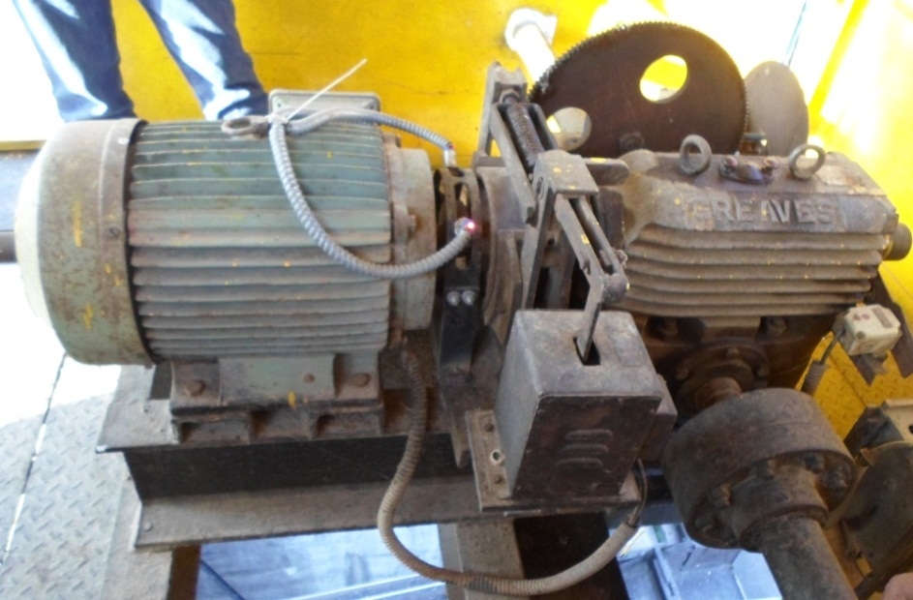
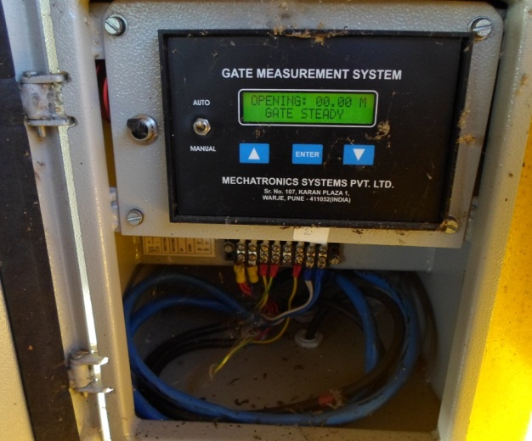
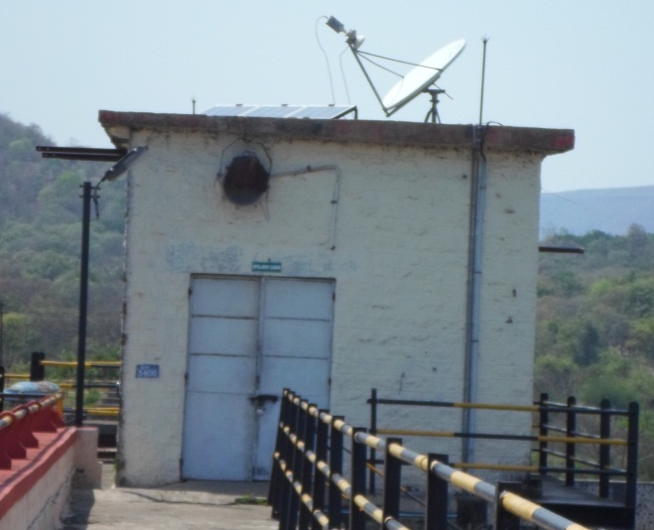
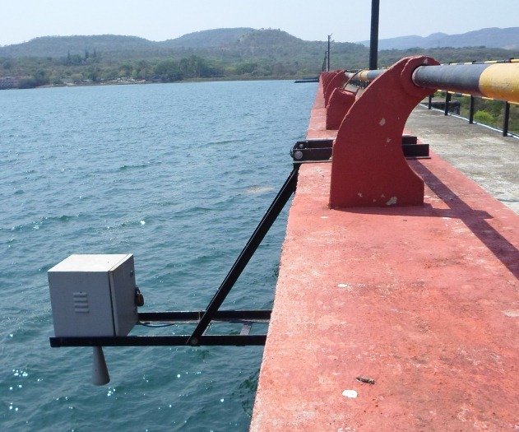
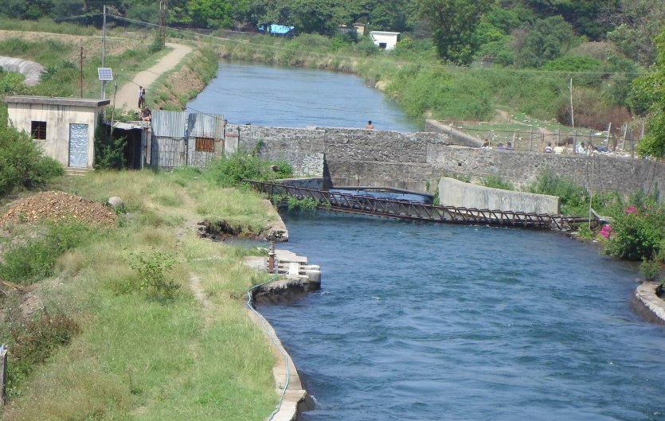
Gate Level Sensor
Example of Kharagwasla Dam
Automatic Weather Station
Dam Water Level Sensor
VSAT Transmission System
Canal Outflow Sensor

Slide 16
